Slide 1

Module Federation and Micro Frontends
An Exploration of Dynamic Module Loading in Frontend Architecture

Slide 2
Agenda
History of Module Federation
What is Module Federation
How It Works
Relationship between Module Federation and Micro-Frontends
Key Concepts of Module Federation
Use Cases for Module Federation
Pros and Cons of Module Federation
Module Federation Demo

Slide 3

History of Module Federation
Origins of Module Federation
The idea of sharing code between multiple applications is not a new one. In fact, it has been a common practice in software development for many years. However, the rise of microservices and the need for highly modular and scalable architectures in web development created a new demand for code sharing across multiple applications.
The first attempts to solve this problem involved using iframes or server-side includes to embed code from one application into another. However, these approaches had significant limitations in terms of performance, flexibility, and security.

Slide 4
History of Module Federation
Webpack 5 and the Birth of Module Federation
In 2020, Webpack 5 was released with a new feature called "Module Federation". This feature was a significant step forward in the evolution of code sharing in web development.
Module Federation allowed developers to share entire modules between multiple applications, not just Redux-related code. This was accomplished by extending the Webpack module bundler to support remote loading of modules and using a runtime called the "Module Federation Runtime" to handle the loading and dependency resolution of remote modules.

Slide 5
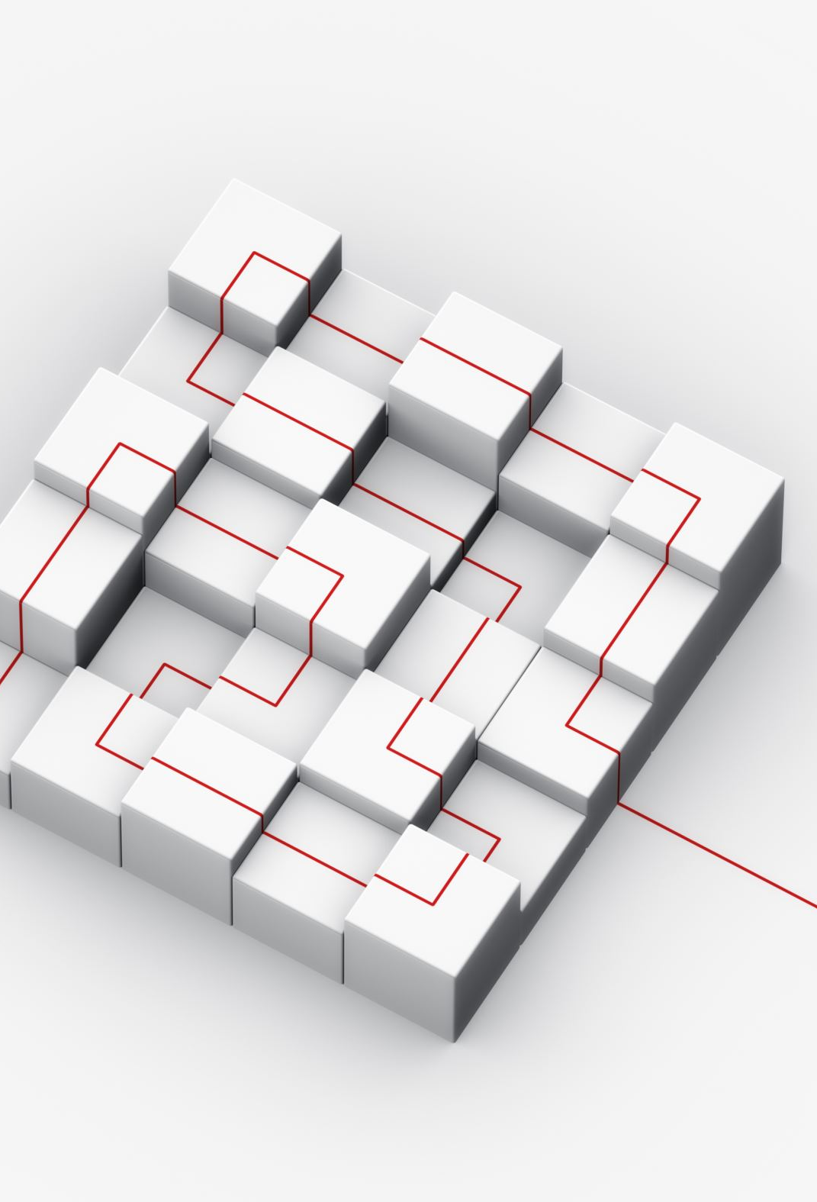
What is Module Federation
Module Federation is a concept in the context of front-end development that enables the sharing of code and resources across multiple independently deployed applications. This concept is particularly relevant in the context of micro frontends, which is an architectural approach to building front-end applications by breaking them down into smaller, independently deployable and scalable units.

Slide 6
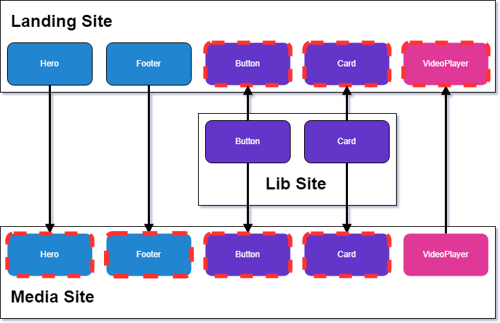
How It Works
Each application exposes specific modules that other applications can consume. These modules can be dynamically loaded and executed in the consumer application, making it possible to share logic, components, and other resources across different parts of the system.

Slide 7

Relationship between Module Federation and Micro-Frontends
Module Federation is a technique that can be used to implement the principles of Micro Frontends. By using Module Federation, different micro frontends can dynamically import and use modules from each other, allowing for better code sharing and collaboration between independent teams.
With Module Federation, each micro frontend can expose specific modules that other micro frontends can consume, creating a more modular and flexible front-end architecture.

Slide 8
Key Concepts of Module Federation
Remote Modules
Exposed Modules
Shared Modules

Slide 9
Remote Modules
These are independent modules or components that reside in separate codebases or repositories. They are designed to be loaded dynamically at runtime by other applications, typically referred to as host applications.
Dynamic Loading:
Remote modules are loaded on demand, meaning they are not bundled with the main application during build time. Instead, they are fetched and integrated into the host application at runtime.
Role of Dynamic Loading:
Enables a more flexible and efficient system by loading only the modules needed for a specific functionality.
Allows for updates and changes to remote modules without requiring a full application redeployment.

Slide 10
Exposed Modules
In the context of Module Federation, exposing modules means making certain components or functionalities available for consumption by other applications. This is achieved by explicitly defining which parts of a module are meant to be shared.
Selective Sharing:
Exposed modules allow developers to selectively share specific functionalities while keeping others private.

Slide 11
Shared Modules
These are modules that contain shared code, assets, or resources that can be utilized by multiple micro frontends. Shared modules promote code reusability and maintainability across the application landscape.
Code and Resource Sharing:
Shared modules facilitate the sharing of common functionalities, such as utility functions, styles, or assets, reducing duplication across micro frontends.
Version Control:
Shared modules can be versioned and updated independently, allowing for a more modular and decentralized approach to development.

Slide 12
Use Cases for Module Federation
Micro-frontend Architecture
Multi-Application Integration
Third-Party Integrations
Shared Libraries

Slide 13
1 Micro-frontend Architecture
One of the most common use cases for Module Federation is in micro-frontend architecture. This approach involves breaking down large monolithic applications into smaller, more manageable frontend modules that can be developed and deployed independently. With Module Federation, these modules can be shared between different applications, allowing for greater flexibility and modularity in application design.
For example, imagine a large e-commerce platform with multiple frontend applications for product search, shopping cart, and checkout. By using Module Federation, the platform could share common modules such as user authentication and payment processing between the different frontend applications, reducing duplication and improving collaboration between development teams.

Slide 14
2 Multi-Application Integration
Another common use case for Module Federation is in integrating multiple applications that share common functionality. With Module Federation, developers can share modules between different applications, allowing them to work together seamlessly and share data more efficiently.
For example, imagine a suite of productivity applications such as a project management tool, a team communication app, and a time-tracking tool. By using Module Federation, these applications could share common modules such as user authentication and data storage, allowing them to work together seamlessly and share data more efficiently.

Slide 15
3 Third-Party Integrations
Module Federation can also be used for integrating third-party modules and applications into an existing application. With Module Federation, developers can easily integrate modules from different sources, allowing them to incorporate external functionality into their applications without having to develop it from scratch.
For example, imagine an e-commerce platform that wants to incorporate a third-party shipping module into their application. With Module Federation, the platform could easily integrate the shipping module into their application, allowing customers to see shipping options and prices in real-time.

Slide 16
4 Shared Libraries
Finally, Module Federation can also be used for sharing libraries and other common code between different applications. With Module Federation, developers can easily share code libraries and other common functionality, reducing duplication and improving collaboration between development teams.
For example, imagine a suite of applications that all require access to a common library of UI components. With Module Federation, these applications could share the UI component library, allowing developers to make changes and improvements to the library in one place, rather than having to make the same changes across multiple applications.

Slide 17
Pros and Cons of Module Federation
Pros | Cons
Reduced Code Duplication | Increased Complexity
Improved Collaboration | Security Risks
Greater Flexibility | Increased Coupling
Improved Performance and Scalability | Potential Performance Issues

Slide 18
Module Federation Demo

